Slide 1
Day 03
Linux Device Driver Training
Linux Operating System
Presented by,
Ganavi M
Ganavigowda512@gmail.com

Slide 2
LINUX OS
Open Source: Linux is an open-source operating system, which means its source code is freely available for anyone to view, modify, and distribute. This open nature fosters collaboration and innovation among developers worldwide.
Variety of Distributions: Linux comes in various distributions (distros), each tailored for specific use cases or preferences. Popular distributions include Ubuntu, Debian, CentOS, Fedora, and Arch Linux, among others.
Kernel: The Linux kernel is the core component of the operating system. It manages hardware resources, provides essential functionalities, and serves as an interface between hardware and software.
Multi-User and Multi-Tasking: Linux supports multiple users and allows concurrent execution of multiple tasks, making it suitable for both personal and enterprise environments.
Command-Line Interface (CLI): Linux offers a powerful command-line interface (CLI) alongside graphical user interfaces (GUIs). The CLI allows users to interact with the system efficiently, perform administrative tasks, and automate tasks through scripting.

Slide 3
HISTORY AND PHILOSOPHY
Origin: Created by Linus Torvalds in 1991 as a hobby project.
Open Source Philosophy: Linux is open source, meaning its source code is freely available for anyone to view, modify, and distribute.
Collaborative Development: Thousands of developers worldwide contribute to Linux, sharing code and ideas through collaborative platforms.
GNU Project: Linux works closely with the GNU Project, which provides essential components for the operating system.
Licensing: Linux is distributed under the GNU General Public License (GPL), ensuring it remains free and open source.
Portability: Linux runs on various hardware architectures, making it versatile and adaptable.

Slide 4
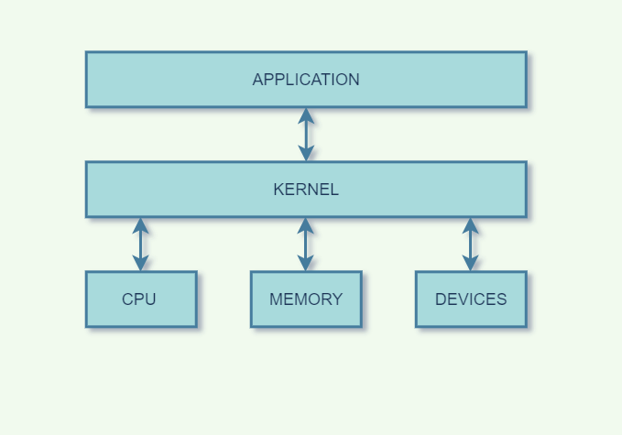
KERNEL
The kernel is the core of the operating system.
Manages hardware resources like CPU, memory, and disk.
Controls processes, scheduling tasks, and managing memory.
Handles communication between software and hardware devices.
Supports file systems for accessing stored data.

Slide 5
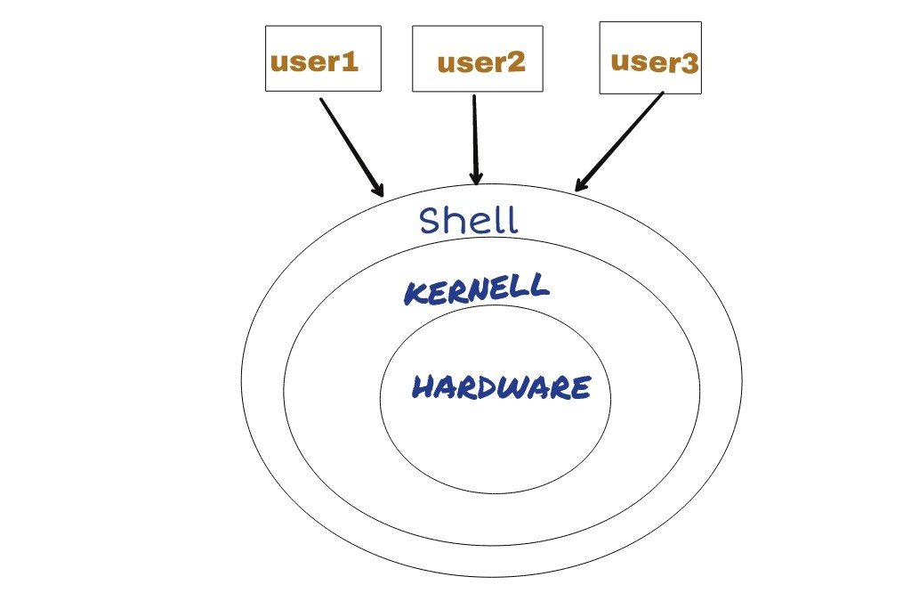
SHELL
The shell is the interface where users interact with the operating system.
What does it do?:
Executes user commands and scripts.
Helps in file management and input/output redirection.
Allows customization of the user environment.
Examples: Bash and Zsh are popular shells in Linux.

Slide 6
FILES AND PROCESSES
Files serve as containers for storing data, programs, or configurations on a computer system, while processes represent running tasks or jobs.
Each file and process has attributes and information associated with it, such as name, size, permissions, and state.
Files are organized within the filesystem hierarchy, whereas processes are managed by the operating system and can communicate with each other.
Access control mechanisms ensure secure management of files, while process management involves creating, scheduling, and terminating processes to efficiently utilize system resources.
Together, files and processes form the backbone of the operating system, enabling users to store and manipulate data while executing tasks concurrently.

Slide 7
DIRECTORIES
Directories, like files, serve as containers for organizing data and programs on a computer system.
Each directory has attributes such as its name and permissions, dictating who can access or modify it.
Directories are organized within the filesystem hierarchy, with folders containing files and other folders.
Access control mechanisms ensure secure management of directories, allowing only authorized users or processes to access or modify them.
Process management involves creating, scheduling, and terminating processes, which can interact with directories to perform tasks such as file manipulation or data retrieval.
Together, directories and processes play vital roles in the organization and execution of tasks within the operating system.
Eg: $ mkdir Documents create the directory named Documents

Slide 8
COMMANDS
ls: List directory contents. Example: ls -l (lists in long format)
cd: Change directory. Example: cd Documents (moves to the Documents directory)
pwd: Print working directory. Example: pwd (displays the current directory)
mkdir: Make directory. Example: mkdir new_directory (creates a new directory named "new_directory")
rm: Remove files or directories. Example: rm file.txt (deletes file.txt)
rmdir: Remove empty directories. Example: rmdir empty_directory (deletes the empty directory "empty_directory")
cp: Copy files or directories. Example: cp file.txt new_location (copies file.txt to new_location)
mv: Move (rename) files or directories. Example: mv file.txt new_name.txt (renames file.txt to new_name.txt)
cat: Concatenate and display files. Example: cat file.txt (displays the contents of file.txt)
FOR HELP:
ls - -help
man ls

Slide 9
ABSOLUTE AND RELATIVE PATH
Absolute paths specify the exact location of a file or directory from the root directory of the filesystem.
For example, ls /home/user/Documents.
This command lists the contents of the "Documents" directory located at the absolute path /home/user/Documents.
Relative paths, on the other hand, specify the location of a file or directory relative to the current working directory.
Assume the current working directory is /home/user.
Command: 'ls Documents'
Explanation: This command lists the contents of the "Documents" directory relative to the current working directory (/home/user). The path Documents is relative because it specifies the directory's location relative to the current directory, rather than its absolute location from the root directory.
In summary, absolute paths start from the root directory and provide the full path to a file or directory, while relative paths specify the location relative to the current working directory.

Slide 10
OWNERSHIP AND PERMISSIONS
The owner is the user who created the file or directory, while the group is a set of users with whom the owner shares permissions.
Ownership information can be viewed using the ls -l command, which displays detailed file information including the owner and group.
Example:$ ls -l /home/user/Documents
drwxr-xr-x 2 owner group 4096 Apr 3 10:00 Documents
Permissions define what actions users and groups can perform on a file or directory, such as reading, writing, or executing.
Permissions are represented by three sets of characters: user (owner), group, and others.
Each set consists of three characters: "r" for read, "w" for write, and "x" for execute. If a permission is granted, the corresponding character is present; otherwise, it's replaced by "-".
Permissions can be viewed using the ls -l command as well.
Example : $ ls -l /home/user/Documents
drwxr-xr-x 2 owner group 4096 Apr 3 10:00 Documents
drwxr-xr-x, which means:
The owner has read, write, and execute permissions (rwx).
The group has read and execute permissions (r-x).
Others have read and execute permissions (r-x).

Slide 11
Thank you

